Slide 1
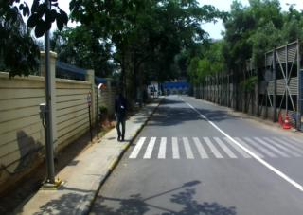
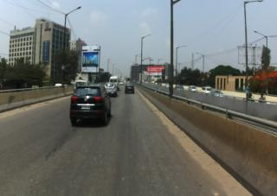
CAPSTONE PROJECT
ON
Semantic Segmentation for Vehicle and Pedestrian detection and classification
INDIAN
RAODS
Presented By :
Shreya Gajanan Patil
HUB ID : HUB20240174
Certificate Program on Machine Learning 2024, IIIT Hyderabad

Slide 2
Problem Statement
The goal of this project is to perform semantic segmentation on Indian road scenes using the Indian Driving Dataset(IDD). Unlike datasets from structured environments like Europe, Indian road conditions present a greater challenge due to diverse object types, irregular lane markings, high traffic density, and occlusions. Accurate segmentation is crucial for applications such as autonomous driving, smart surveillance, and traffic analysis.

Slide 3
Approach
Use pre-labeled PNG masks from the IDD dataset.
Perform image-mask visualization using OpenCV and Matplotlib.
Extract target classes such as car, motorcycle, autorickshaw, person, truck, and road.
Generate segmentation masks, draw bounding boxes, and create
an overlay visualization.
Output details to a CSV file for further analysis or model training support.

Slide 4
Tools Used
Python for implementation
OpenCV for image processing
NumPy and Pandas for array/mask handling and data storage
Matplotlib for visual presentation
Google Colab as the development environment
IDD Dataset for real-world Indian traffic images and masks

Slide 5
Challenges Faced
The masks were in PNG form, not polygon JSON files But I made it work using class 1, which represents the road.
Small or Fragmented Objects Not Detected Well
Many mask images only contained 0 and 1, meaning only the background and road were labeled.
To large dataset which was unable to handle

Slide 6

Drawbacks Future Scope
Limited Class Detection
Model Generalization Limited
Over-Simplified Visualizations
Use Full IDD Level 3 Annotations
Train a Deep Model
Integrate with ADAS Systems

Slide 7
Conclusion
Successfully implemented a visualization pipeline for semantic segmentation using the IDD dataset.
The system works for available labels but is limited by class diversity in selected samples.
Can be extended by:
Training a DeepLabV3+ or U-Net model on the full dataset.
Expanding to multi-class segmentation when richer mask classes are available.
Integrating real-time inference and interactive annotation tools.

Slide 8

THANK
YOU
FOR YOUR
PRECIOUS TIME

